Slide 1
Cameras and Projection
CSCI 4150/6050: Computer Vision

Slide 2
Projection
To get 2D pictures of a 3D world, you have to use projection
  Orthographic
    Sometimes used in computer graphics
  Perspective
    How physical cameras capture images

Slide 3
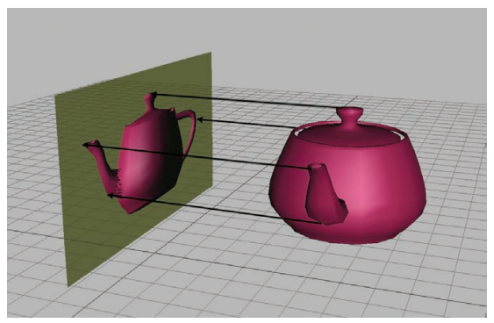
Orthographic Projection
Orthographic projection is just dropping a dimension.
Used in technical drawings, etc.

Slide 4
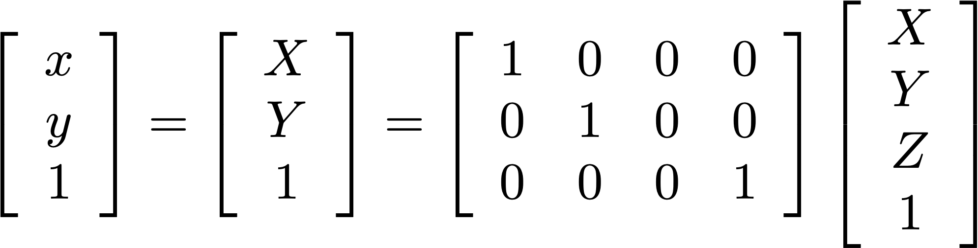
Orthographic Projection
3D point in
homogeneous
coordinates
Orthographic projection is just dropping a dimension.

Slide 5
Lacking Perspective

Slide 6
This is not how physical cameras work, so we won’t work with orthographic projection in this class.

Slide 7
Perspective Projection

Slide 8
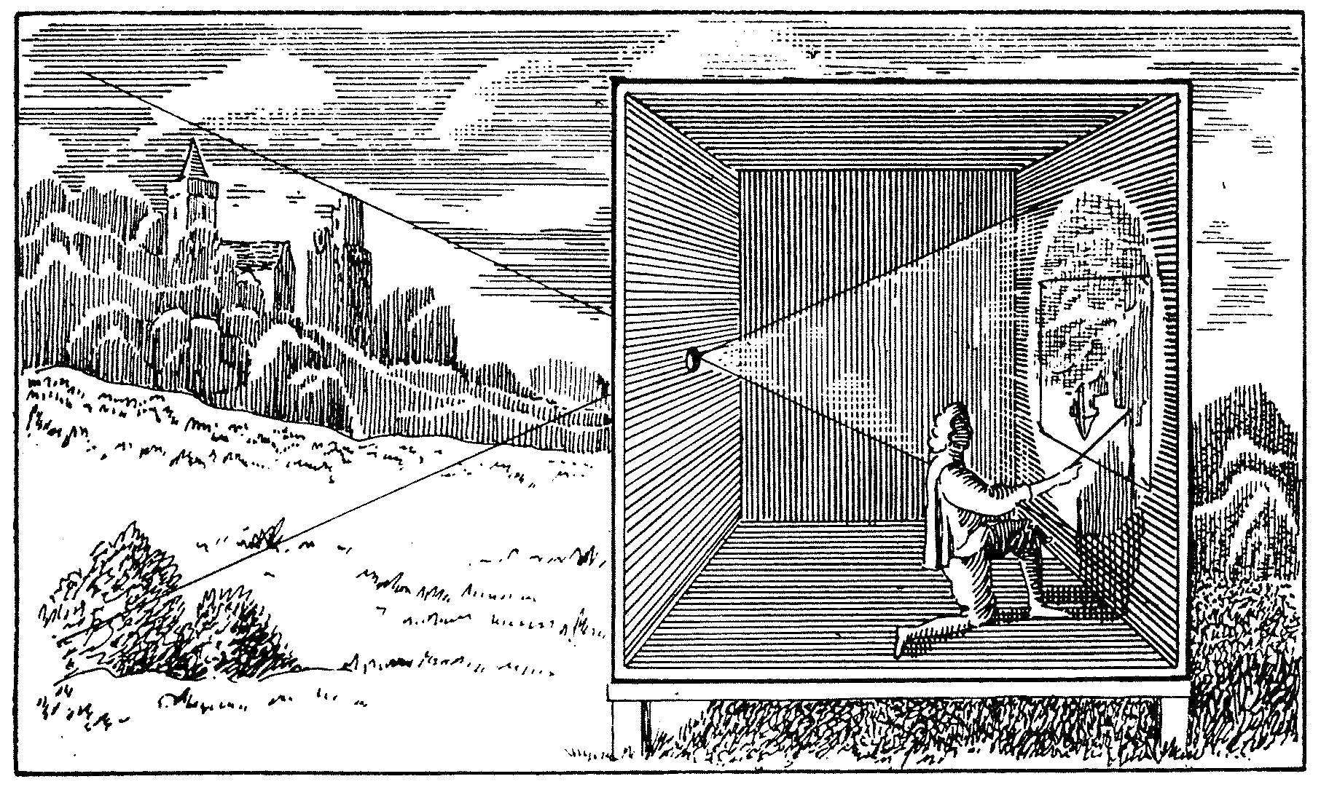
Camera Obscura

Slide 9
The Pinhole Camera
https://www.bhphotovideo.com/images/images500x500/Santa_Barbara_TEL9RO_4_x_5_Pinhole_151512.jpg
https://upload.wikimedia.org/wikipedia/commons/thumb/7/71/Camera_Oscura.jpg/220px-Camera_Oscura.jpg

Slide 10
Aside: Eclipse Viewing

Slide 11
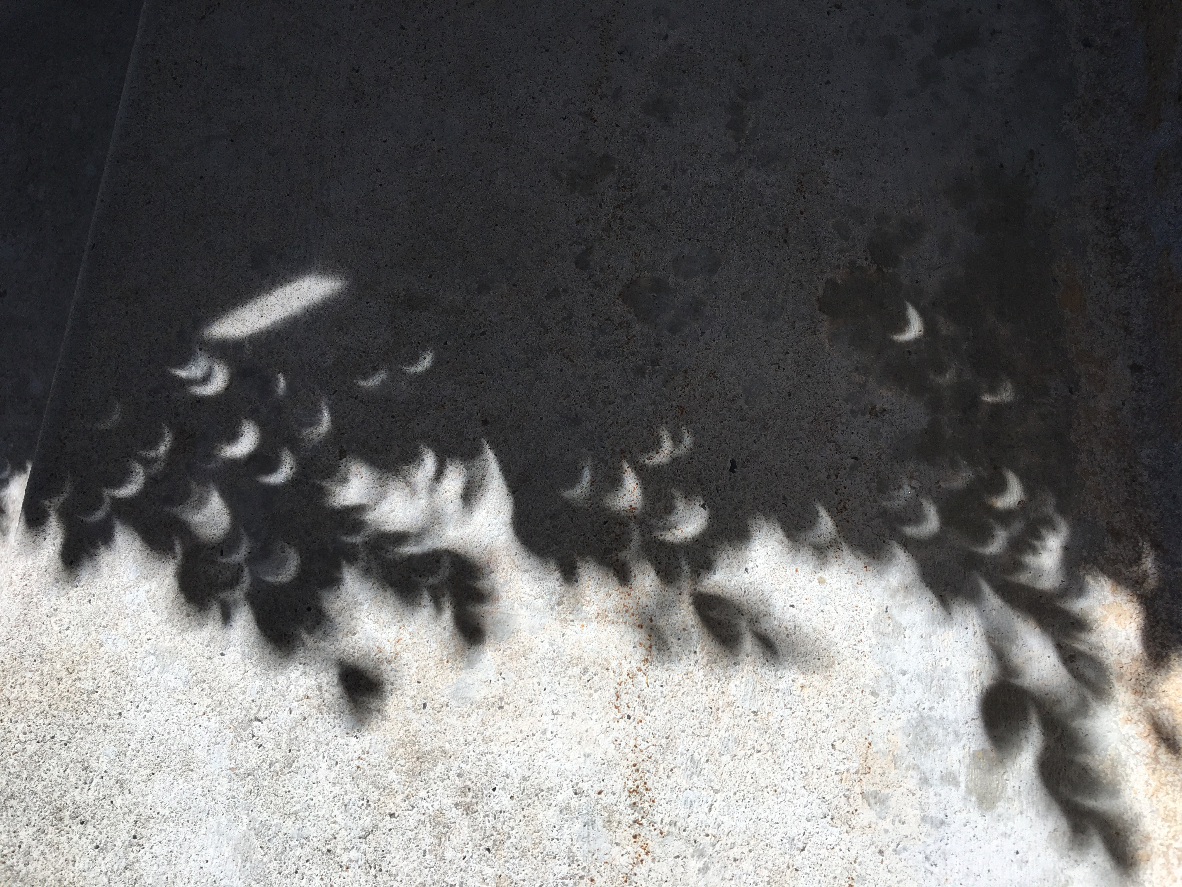
Aside: Eclipse Viewing

Slide 12
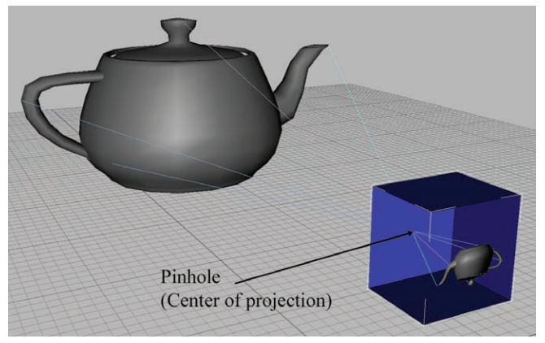
Perspective Projection
Many graphics systems assume a
simple pinhole camera model

Slide 13
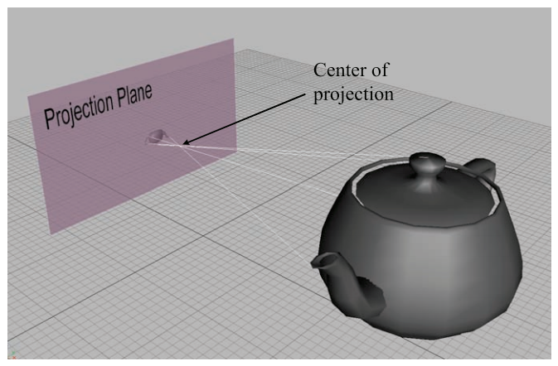
Perspective Projection
Pinhole camera model

Slide 14

Pinhole Cameras
focal point
focal length
optical axis
imaging
sensor
field of view

Slide 15
Geometric Model
focal point
focal length
optical axis
imaging
sensor
virtual
imaging
plane
field of view

Slide 16
Geometric Model
focal point
focal length
optical axis
virtual
imaging
plane
field of view

Slide 17



Camera Coordinates
focal
point
optical axis
virtual
imaging
plane
field of view

Slide 18
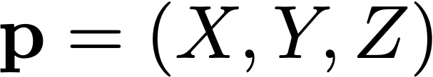
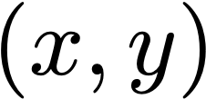
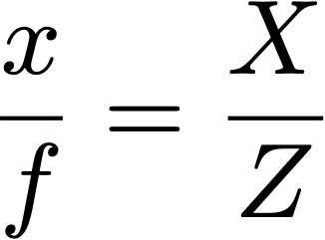
Projection
focal
point
optical axis
By similar triangles:
virtual
imaging
plane

Slide 19
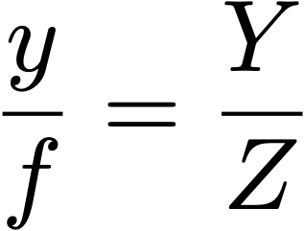
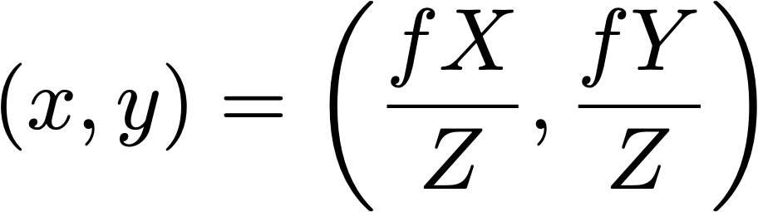
Projection
Note: this is the projected coordinate in real-world units.
To get actual pixel location, scale by pixel density
and apply offset to image origin (more on this later...)

Slide 20
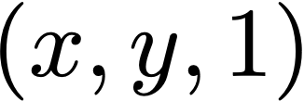
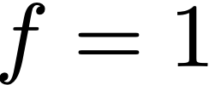
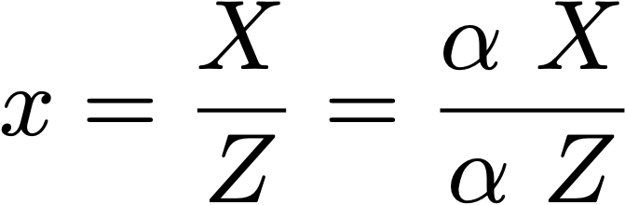
Projection
homogeneous coordinate!
focal
point
optical axis
By similar triangles:
virtual
imaging
plane

Slide 21
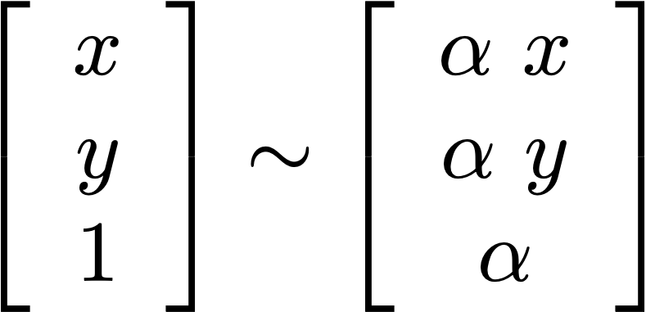
Key Idea: Homogenous Coordinates
Homogeneous coordinates are used to represent all 3D points along the ray that falls on the same 2D projection:

Slide 22
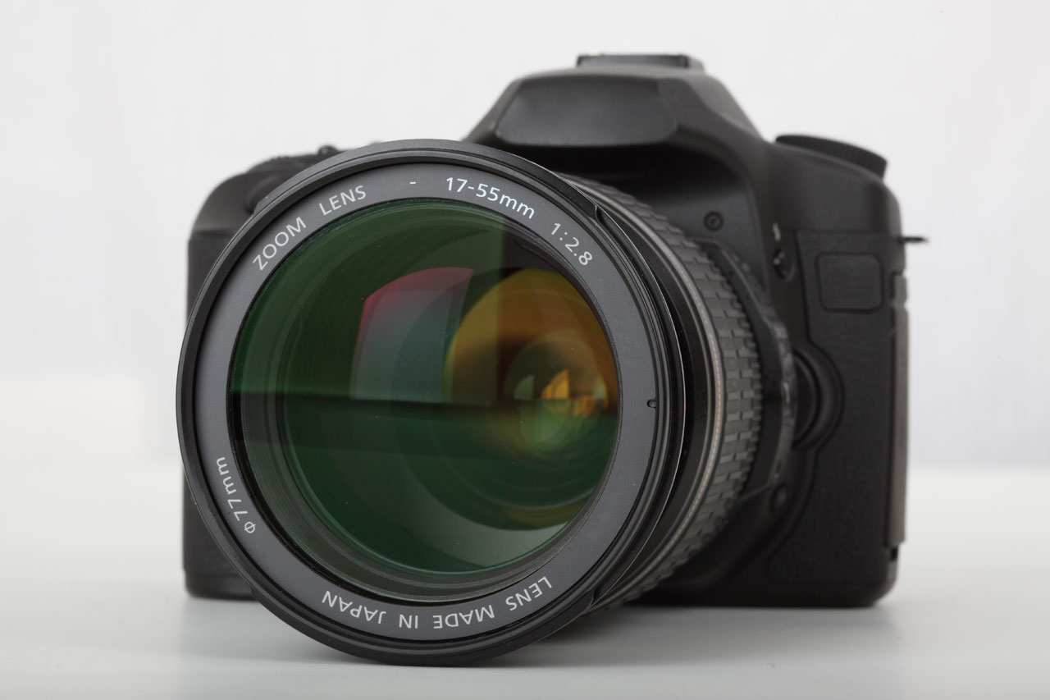
Cameras
We can think of cameras as sampling a signal (i.e. photons).
There are fundamental limitations in the acquisition of that signal.

Slide 23
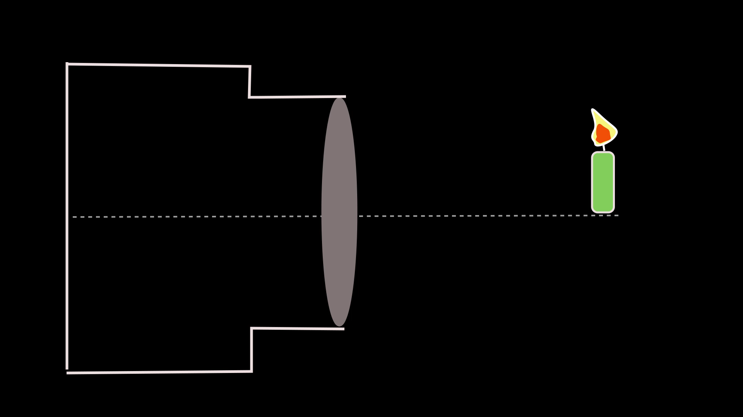
Still works like a Pinhole Camera

Slide 24
Single Lens Reflex (SLR)
http://www.dptips-central.com/image-files/slr_camera.gif

Slide 25
Digital Photography (DLSR)
https://www.bhphotovideo.com/images/images2500x2500/canon_1263c006_eos_80d_dslr_camera_1225877.jpg
https://en.wikipedia.org/wiki/Digital_single-lens_reflex_camera#/media/File:E-30-Cutmodel.jpg

Slide 26
Signal Acquisition: CMOS Chips
Converts light (photons) to chemical and/or electrical response
https://s.hswstatic.com/gif/digital-camera-1.jpg
https://upload.wikimedia.org/wikipedia/commons/thumb/3/37/Bayer_pattern_on_sensor.svg/2560px-Bayer_pattern_on_sensor.svg.png

Slide 27
Bayer Patterns
Most commercial-grade cameras sample only one color per pixel
Small colored filter over each sensor element
16 megapixels =
  8 megapixels green
  4 megapixels red
  4 megapixels blue
You get interpolated combination

Slide 28
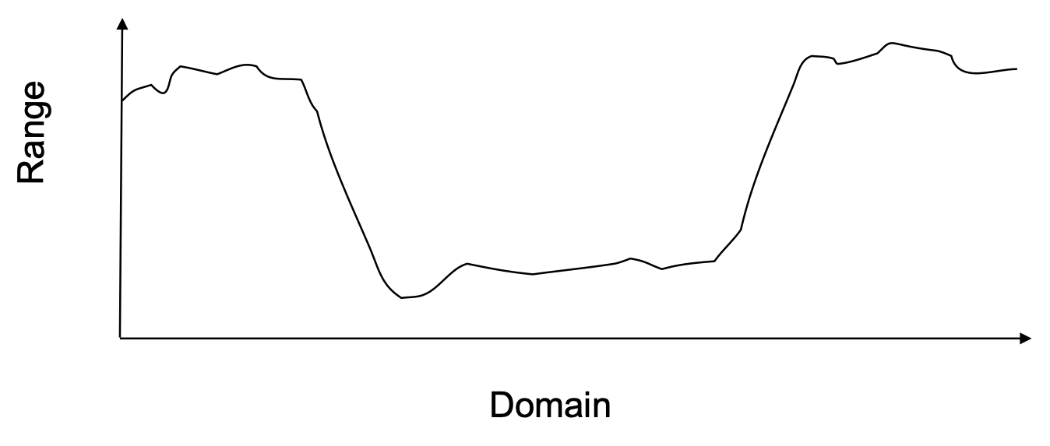
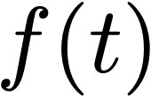
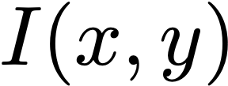
Signals as Functions
Digital signals can be thought of as sampled functions
Domains:
  Time (audio)
  Space (images)
  Both (video)
Ranges:
  Changing air pressure (audio)
  Visible light (photographs, video)
  Other properties
  (X-rays, MRI, range images, etc.)

Slide 29
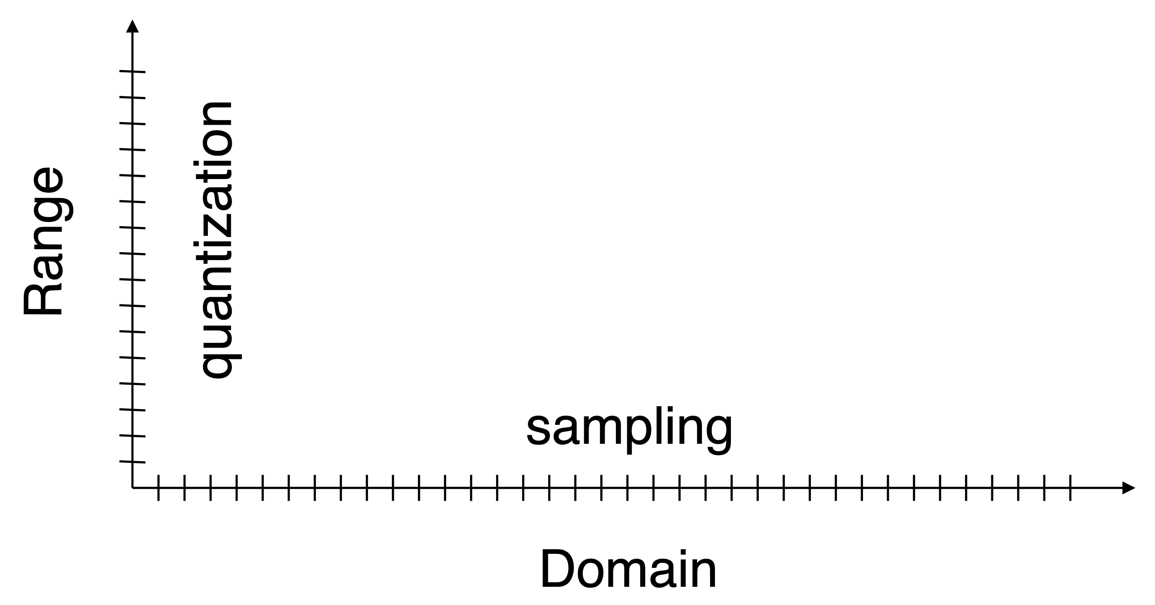
Sampling vs. Quantization

Slide 30
Sampling
Samples per unit length, area, etc.
Often expressed as
  rate
  spacing
  density

Slide 31
Quantization
Levels of precision in each sample
Usually
  number of levels
  number of bits

Slide 32
Sampling vs. Quantization
600 dots per inch
black and white images
256-level grey
8-bit grey
30 frames per second
24-bit color
44.1 KHz audio
16-bit audio

Slide 33
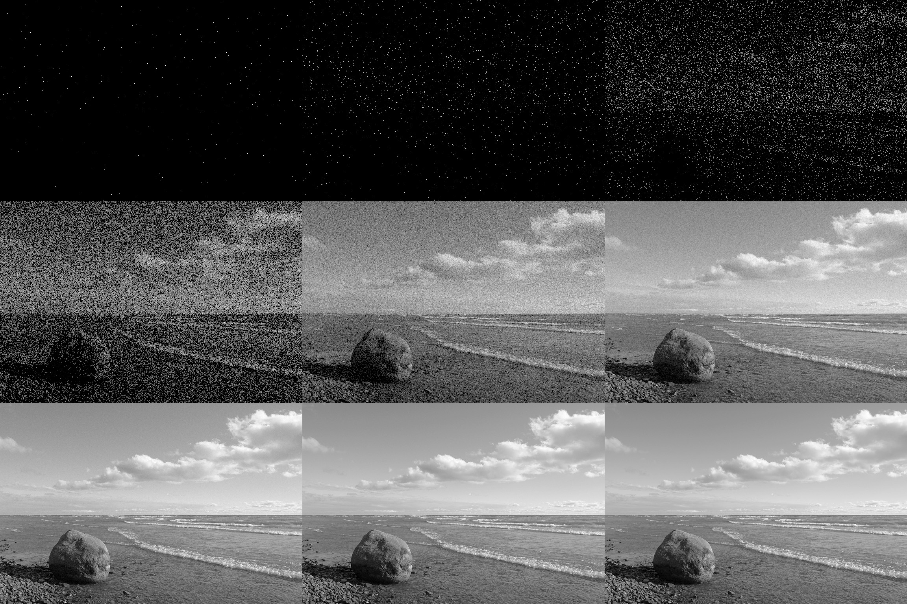
Shot Noise

Slide 34
Shot Noise
Unavoidable random fluctuations from “correct” value
The only way to reduce quantum noise is to collect more light
  Turn up the source (usually not an option)
  Larger aperture
  Collect for longer

Slide 35
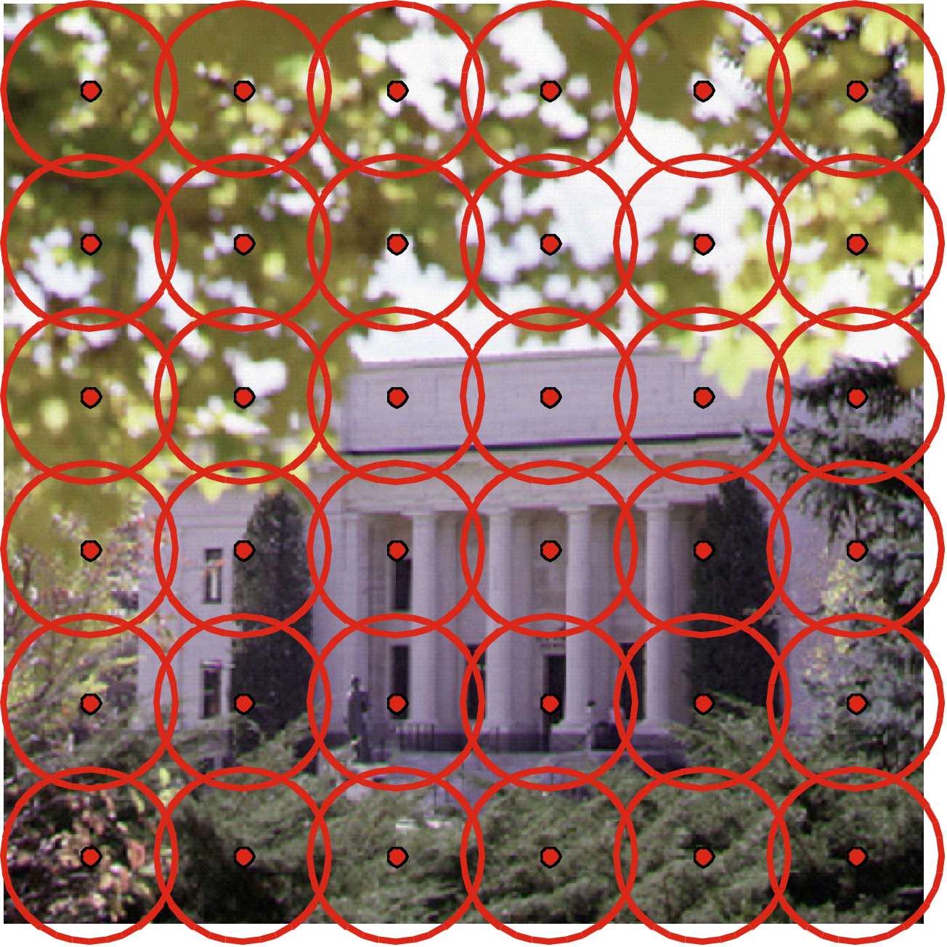
Apertures
Pixels aren’t point samples
Total light over an area
of the visible scene
Controlled by the camera’s iris
(photographers: F-stop)
Also caused by physical sensor area (pixel’s area on the camera’s sensor)

Slide 36
Apertures
Sampling and size of aperture determine visual resolution
  Smaller apertures = better resolution
  Larger apertures = worse resolution
Lenses allow a physically larger aperture to act as an effectively smaller one

Slide 37


Visual Resolution

Slide 38

Exposure Time
How long you collect light to create an image
Controlled by how long the shutter remains open on the camera
The longer the exposure time, the more motion blur that can occur in the image.

Slide 39
Exposure Time
Short exposure time applications
  Sports Photography
  Portraits
Long exposure time applications
  Landscape Photography
  Night Photography

Slide 40

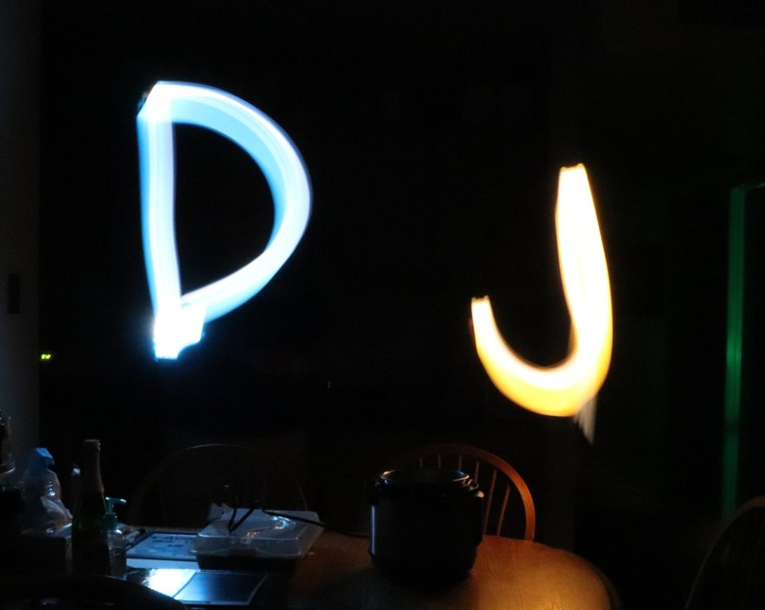
Aside: Light Blur Effects

Slide 41
The Lighting Triangle
Large
Aperture
Long
Exposure
Small Aperture
Short
Exposure
The less light in the scene, the higher you need to get!

Slide 42
Physical Limitations of Cameras
Shot Noise
Spatial blur
Motion blur
Bayer sampling artifacts
Lens distortion
Chromatic aberration
Color balance
Tone mapping
(color responses)
Moiré Patterns

Slide 43
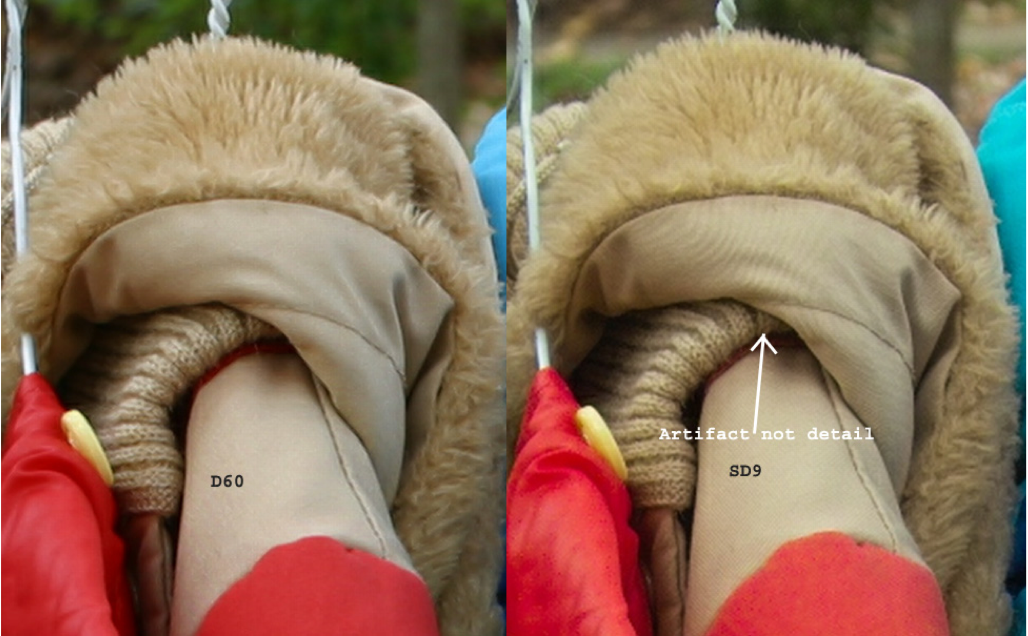
Moiré Patterns

Slide 44
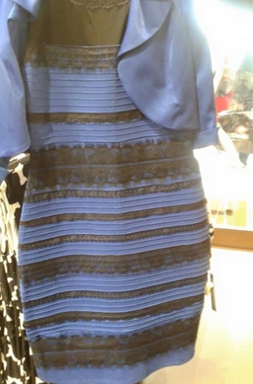
Is it blue and black or white and gold?

Slide 45
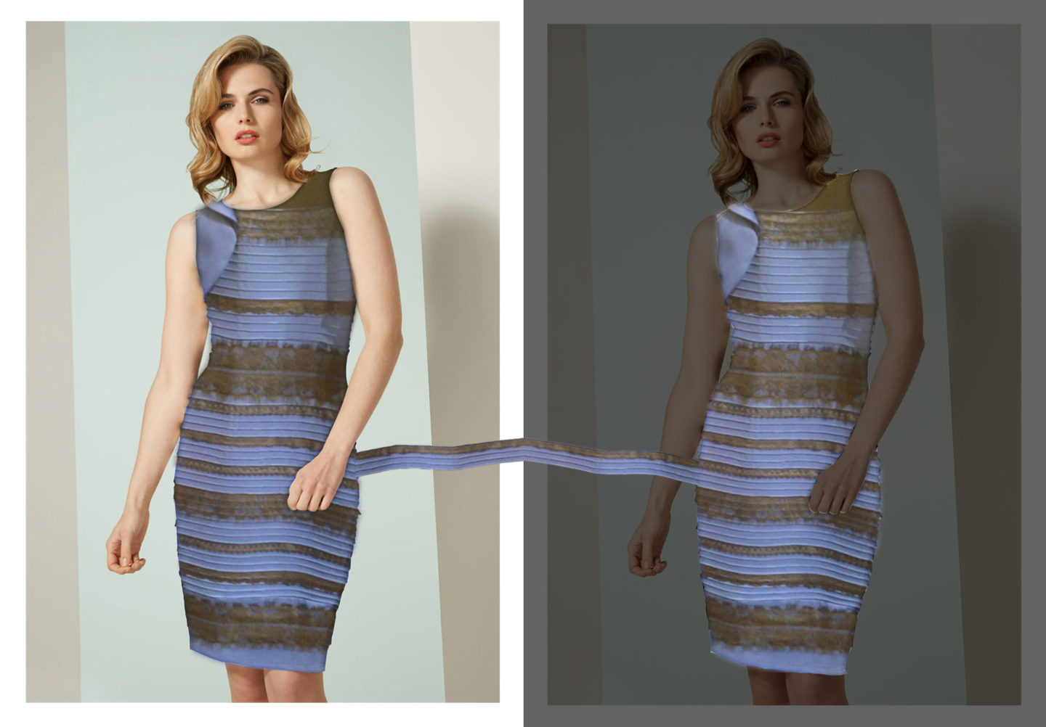
Lighting makes a big difference…

